Slide 1
George Boole
George Boole’s work is considered by
many the starting point of Boolean
Algebra. His work is also considered
as a beginning of sorts for Comp Sci.
Alice in Wonderland
Lewis Carroll
Notes:
George Boole is credited with laying the foundation for Boolean Algebra. The work of George Boole is still very important today.

Slide 2
Operator Precedence
 |  | Associativity
HIGH | ! ++ -- (type) ← typecast | L←R
 | * / % | L→R
 | + - | L→R
 | < <= > >= | L→R
 | == != | L→R
 | & (Full evaluation logical and ) | L→R
 | ^ (Full evaluation logical xor ) | L→R
 | | (Full evaluation logical or ) | L→R
 | && (Short circuited logical and ) | L→R
 | || (Short circuited logical or ) | L→R
 | = += -= *= /= %= | L←R
LOW | , | L→R
Notes:
(type) represents a typecast.

Slide 3
Common Boolean Symbols
Name | Boolean Symbol | Java Counterpart
and | ۸ logical and | &&
or | ۷ logical or | ||
not | ¬ logical not | !
xor | logical xor (exclusive or) | ^
Notes:
And is used to see if all parts are true. In some languages, and is actually written as a word. In other languages, and is written as a symbol, like && or &.
Or is used to see if any part is true. In some languages, or is actually written as a word. In other languages, or is written as a symbol, like || or |.
Not is used to negate a boolean value. In some languages, not is actually written as a word. In other languages, not is written as a symbol, like !.

Slide 4
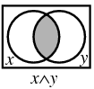
AND
C ۸ S C && S
C | S | C && S
0 | 0 | 0
0 | 1 | 0
1 | 0 | 0
1 | 1 | 1

Slide 5
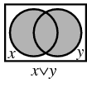
OR
C ۷ S C || S
C | S | C || S
0 | 0 | 0
0 | 1 | 1
1 | 0 | 1
1 | 1 | 1

Slide 6
NOT
¬ C ! C
C | ! C
0 | 1
1 | 0

Slide 7
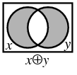
XOR
C ⊕ S C ^ S
C | S | C ^ S
0 | 0 | 0
0 | 1 | 1
1 | 0 | 1
1 | 1 | 0

Slide 8
Short
Circuit
Evaluation

Slide 9
Post/Pre-increment
5
int num = 2 + 3;
out.println(num++);
out.println(++num);
OUTPUT
5
7
Notes:
num starts out with the value 11. num=11
++ is the same as num=num+1
num is then increased by 1. num = 12
-- is the same as num=num-1
num is then decreased by 1. num = 11
num is then increased by 1. num = 12

Slide 10
Post/Pre-increment
int num = 5 6 7;
out.println(num++);
out.println(++num);
OUTPUT
5
7
5
7
Notes:
num starts out with the value 11. num=11
++ is the same as num=num+1
num is then increased by 1. num = 12
-- is the same as num=num-1
num is then decreased by 1. num = 11
num is then increased by 1. num = 12

Slide 11
Crazy Mistake Using ++
int x = 5;
x = x++;
out.println(x);
OUTPUT
5
Notes:
num starts out with the value 11. num=11
++ is the same as num=num+1
num is then increased by 1. num = 12
-- is the same as num=num-1
num is then decreased by 1. num = 11
num is then increased by 1. num = 12

Slide 12
Crazy Mistake Using ++
First, x is created in memory and stores 5:
int x = 5;
x = x++;
out.println(x);
x
5
Notes:
num starts out with the value 11. num=11
++ is the same as num=num+1
num is then increased by 1. num = 12
-- is the same as num=num-1
num is then decreased by 1. num = 11
num is then increased by 1. num = 12

Slide 13
Crazy Mistake Using ++
Next, the ++ increments x to 6, but returns 5 to the =:
int x = 5;
x = x++;
out.println(x);
x
6
5
Notes:
Next, the post-increment operator increments x to 6, but returns the original value of 5 to the assignment operator:

Slide 14
Crazy Mistake Using ++
Now the = stores the 5 it was given into x:
int x = 5;
x = x++;
out.println(x);
x
5
5
Notes:
Next, the post-increment operator increments x to 6, but returns the original value of 5 to the assignment operator:

Slide 15
Post/Pre-increment
When is it appropriate to use post-increment inside another expression?
int[] ray = new int[100];
int count = 0;
Scanner file = new Scanner(new File("data.dat"));
while(file.hasNext ())
ray[count++] = file.nextInt();
Notes:
num starts out with the value 11. num=11
++ is the same as num=num+1
num is then increased by 1. num = 12
-- is the same as num=num-1
num is then decreased by 1. num = 11
num is then increased by 1. num = 12

Slide 16
Short Circuit Evaluation
Java evaluates boolean expressions
from left to right in most situations
and stops the evaluation process as soon as it knows the answer, even if it hadn’t analysed the whole expression.

Slide 17
Short Circuit Evaluation || or
OR short circuits when the 1st expression is true.
int total=7, num=10;
if (total<4 || ++num<12)
{
out.println("true");
}
out.println(num);
OUTPUT
true 11
Notes:
If total<4 is true, ++num<15 is never evaluated.
If total<4 is false, ++num<15 is evaluated.
total<4 is false so ++num<15 is evaluated. 14 is less than 15 so short is printed.

Slide 18
Short Circuit Evaluation || or
OR short circuits when the 1st expression is true.
int total=7, num=10;
if (total>4 || ++num<12)
{
out.println("true");
}
out.println(num);
OUTPUT
true 10
Notes:
If total<4 is true, ++num<15 is never evaluated.
If total<4 is false, ++num<15 is evaluated.
total<4 is false so ++num<15 is evaluated. 14 is less than 15 so short is printed.

Slide 19
Short Circuit Evaluation && and
AND short circuits when the 1st expression is false.
int total=7, num=10;
if (total>4 && ++num>12)
{
out.println("true");
}
out.println(num);
OUTPUT
11
Notes:
If total>4 is false, ++num<15 is never evaluated.
If total>4 is true, ++num<15 is evaluated.
total>4 is true so ++num<15 is evaluated. 14 is less than 15 so short is not printed.

Slide 20
Short Circuit Evaluation && and
AND short circuits when the 1st expression is false.
int total=7, num=10;
if (total<4 && ++num>12)
{
out.println("true");
}
out.println(num);
OUTPUT
10
Notes:
If total>4 is false, ++num<15 is never evaluated.
If total>4 is true, ++num<15 is evaluated.
total>4 is true so ++num<15 is evaluated. 14 is less than 15 so short is not printed.

Slide 21
Short Circuit
OR short circuits on an initial true
AND short circuits on an initial false

Slide 22
Short Circuit Evaluation && and || or
What if there is no object?
int countOdds(String str)
{
if ( str == null || str.length() == 0) {
return 0;
}
return str.substring(1);
}

Slide 23
Short Circuit Evaluation && and || or
What if there is no object?
int countOdds(String str)
{
if (str.length() == 0 || str == null) {
return 0;
}
return str.substring(1);
}

Slide 24
Short Circuit Evaluation && and || or
What if there is no object?
int countOdds(String str)
{
if ( str != null && str.length() > 0) {
return str.substring(1);
}
return 0;
}

Slide 25
Short Circuit Evaluation && and || or
Even though && has the higher precedence, first check whether the || short circuits.
int total=7, num=10;
if ( total>4 || ++num>12 && total>0 )
{
out.println("true");
}
out.println(num);
OUTPUT
true 10
The && never happens!

Slide 26
Short Circuit Evaluation && and || or
Even though && has the higher precedence, first check whether the || short circuits.
int total=7, num=10;
if ( total<4 || ++num>12 && total>0 )
{
out.println("true");
}
out.println(num);
OUTPUT
11

Slide 27
Short Circuit Evaluation && and || or
Now the left side of the && is evaluated, then the &&, then the ||. Both the && and the || might be short circuited!
int total=7, num=10;
if (++num>12 && total>0 || total>4 )
{
out.println("true");
}
out.println(num);
OUTPUT
true 11

Slide 28
Common
Boolean
Laws

Slide 29
Distributive Law
c && (s || i) = c&&s || c&&i
c || s && i = (c||s) && (c||i)
This is used now and again by AP and UIL!
Notes:
The Distributive Law is a basic algebraic law.
In the expressions above, distributing the term on the outside of parenthesis to each group inside the parenthesis is equivalent to the original expression.
C and (S or I) is equal to (C and S) or (C and I).
C or (S and I) is equal to (C or S) and (C or I).

Slide 30
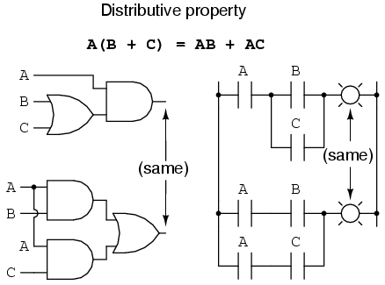
OR Distributive Law
A && (B || C) == A&&B || A&&C
Boolean Algebra Notation:
A(B + C) = AB + AC

Slide 31



x is positive && (x<30 || x is even)
x % 2 == 0
(x is positive && x<30) || (x is positive && x is even)
x < 30
x > 0

Slide 32
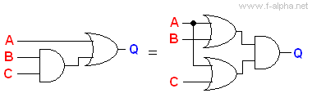
AND Distributive Law
A || (B && C) == (A||B) && (A||C)
Boolean Algebra Notation:
A + BC = (A + B)(A + C)

Slide 33

x is positive || (x<30 && x is even)
x % 2 == 0
(x is positive || x<30) && (x is positive || x is even)
x < 30
x > 0

Slide 34
x>3 || (x<3 && x is even)
(x>3 || x<3) && (x>3 || x is even)

Slide 35
Equivalent Boolean Expressions Example 1
boolean c=true,s=true,i=false,ans;
ans = ( ( c && (s || i) ) == ( (c && s) || (c && i) ) );
System.out.println(ans);
OUTPUT
true
Notes:
The Distributive Law is a basic algebraic law.
In the expressions above, distributing the term on the outside of parenthesis to each group inside the parenthesis is equivalent to the original expression.
C and (S or I) is equal to (C and S) or (C and I).
C or (S and I) is equal to (C or S) and (C or I).

Slide 36
Equivalent Boolean Expressions Example 2
int a=5, b=9, c=3;
boolean ans;
ans = ( a>b && (a<b && a>c)) == ((a>b && a<b) || (a>b && a>c));
System.out.println(ans);
OUTPUT
true
Notes:
The Distributive Law is a basic algebraic law.
In the expressions above, distributing the term on the outside of parenthesis to each group inside the parenthesis is equivalent to the original expression.
C and (S or I) is equal to (C and S) or (C and I).
C or (S and I) is equal to (C or S) and (C or I).

Slide 37
Truth Table Example 1
a | b | c | b || c | a && (b || c)
1 | 1 | 1 | 1 | 1
1 | 1 | 0 | 1 | 1
1 | 0 | 1 | 1 | 1
1 | 0 | 0 | 0 | 0
0 | 1 | 1 | 1 | 0
0 | 1 | 0 | 1 | 0
0 | 0 | 1 | 1 | 0
0 | 0 | 0 | 0 | 0
Notes:
The law is absorption is essentially stating that C is the determinant of the expression.
C or (C and S) is equal to ((C or C) and (C or S)). C’s value determines the value of the entire expression. If C is false, the expression is false. If C is true, the expression is true.

Slide 38
Truth Table Example 1
a | b | c | a && b | a && c | (a && b) || (a && c)
1 | 1 | 1 | 1 | 1 | 1
1 | 1 | 0 | 1 | 0 | 1
1 | 0 | 1 | 0 | 1 | 1
1 | 0 | 0 | 0 | 0 | 0
0 | 1 | 1 | 0 | 0 | 0
0 | 1 | 0 | 0 | 0 | 0
0 | 0 | 1 | 0 | 0 | 0
0 | 0 | 0 | 0 | 0 | 0
Notes:
The law is absorption is essentially stating that C is the determinant of the expression.
C or (C and S) is equal to ((C or C) and (C or S)). C’s value determines the value of the entire expression. If C is false, the expression is false. If C is true, the expression is true.

Slide 39
Truth Table Example 1
a && (b || c) | == | (a && b) || (a && c)
1 | ? | 1
1 | ? | 1
1 | ? | 1
0 | ? | 0
0 | ? | 0
0 | ? | 0
0 | ? | 0
0 | ? | 0
Notes:
The law is absorption is essentially stating that C is the determinant of the expression.
C or (C and S) is equal to ((C or C) and (C or S)). C’s value determines the value of the entire expression. If C is false, the expression is false. If C is true, the expression is true.

Slide 40
Truth Table Example 1
a && (b || c) | == | (a && b) || (a && c)
1 | 1 | 1
1 | 1 | 1
1 | 1 | 1
0 | 1 | 0
0 | 1 | 0
0 | 1 | 0
0 | 1 | 0
0 | 1 | 0
Notes:
The law is absorption is essentially stating that C is the determinant of the expression.
C or (C and S) is equal to ((C or C) and (C or S)). C’s value determines the value of the entire expression. If C is false, the expression is false. If C is true, the expression is true.

Slide 41
DeMorgan's Law
!(c||s) == !c && !s
!(c&&s) == !c || !s
This is always used by AP and UIL!
Notes:
Demorgan’s Law is useful to get a better picture of how the not affects the expression.
The easiest way to evaluate a negated expression is to simply evaluate the expression and then apply the negation.
If the expression is true, applying the negation makes the condition false.
If the expression is false, applying the negation makes the condition true.

Slide 42
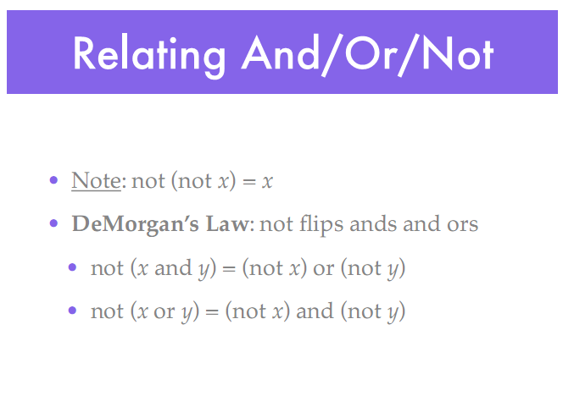

Slide 43
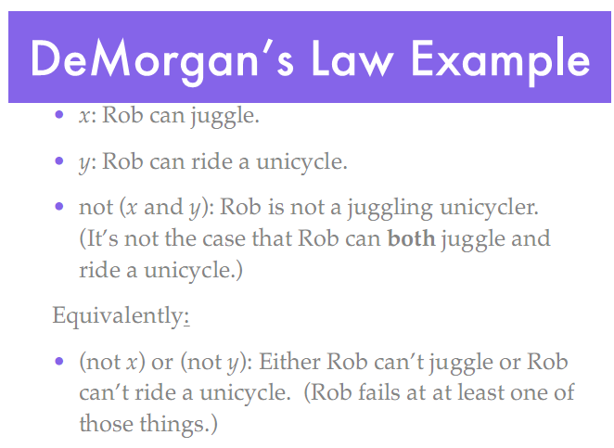

Slide 44
DeMorgan’s Law
!(x>5 || x is even) == !(x>5) && !(x is even)
== x<=5 && x is odd
!(x>5 && x is even) == !(x>5) || !(x is even)
== x<=5 || x is odd

Slide 45
Start work
on Lab 10

Slide 46
open
distributivelaw.java

Slide 47
Absorption Law
C ۸ (C ۷ S) = C
c&&(c||s) = c&&c || c&&s = c
C ۷ (C ۸ S) = C
c||(c&&s) = c||c && c||s = c
This is used now and again by AP and UIL!
Notes:
The law is absorption is essentially stating that C is the determinant of the expression.
C and (C or S) is equal to ((C and C) or (C and S)). C’s value determines the value of the entire expression. If C is false, the expression is false. If C is true, the expression is true.

Slide 48
Boolean Example 2
boolean c = true;
boolean s = false;
boolean i = c || (c&&s);
System.out.println(i);
c | s | i
1 | 1 | 1
1 | 0 | 1
0 | 1 | 0
0 | 0 | 0
OUTPUT
true
Notes:
The law is absorption is essentially stating that C is the determinant of the expression.
C or (C and S) is equal to ((C or C) and (C or S)). C’s value determines the value of the entire expression. If C is false, the expression is false. If C is true, the expression is true.

Slide 49
Boolean Example 3
boolean c = false;
boolean s = true;
boolean i = c && (c||s);
System.out.println(i);
c | s | i
1 | 1 | 1
1 | 0 | 1
0 | 1 | 0
0 | 0 | 0
OUTPUT
false
Notes:
The law is absorption is essentially stating that C is the determinant of the expression.
C and (C or S) is equal to ((C and C) or (C and S)). C’s value determines the value of the entire expression. If C is false, the expression is false. If C is true, the expression is true.

Slide 50
open
absorptionlaw.java

Slide 51
More
Boolean
Laws

Slide 52
DeMorgan's Law
!(c||s) == !c && !s
!(c&&s) == !c || !s
This is always used by AP and UIL!
Notes:
Demorgan’s Law is useful to get a better picture of how the not affects the expression.
The easiest way to evaluate a negated expression is to simply evaluate the expression and then apply the negation.
If the expression is true, applying the negation makes the condition false.
If the expression is false, applying the negation makes the condition true.

Slide 55
DeMorgan’s Law
!(x>5 || x is even) == !(x>5) && !(x is even)
== x<=5 && x is odd
!(x>5 && x is even) == !(x>5) || !(x is even)
== x<=5 || x is odd

Slide 56
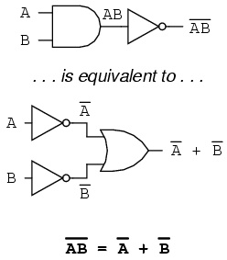
DeMorgan’s Law

Slide 57
!( a <= b || !(a*b <= 0) )
is the same as
a > b || a*b > 0
a > b || a*b <= 0
a <= b || a*b > 0
a > b && a*b > 0
a > b && a*b <= 0
a <= b && a*b > 0

Slide 58
!( a <= b || !(a*b <= 0) )
!(a <= b) && !!(a*b <= 0)
a > b && a*b <= 0
a > b || a*b > 0
a > b || a*b <= 0
a <= b || a*b > 0
a > b && a*b > 0
a > b && a*b <= 0
a <= b && a*b > 0
a > b && a*b <= 0

Slide 59
AND
&&
all conditions must be true
if (c==true && s==true)
{
do something 1;
do something 2;
}
C | S | I
0 | 0 | 0
0 | 1 | 0
1 | 0 | 0
1 | 1 | 1
Notes:
And is used to see if all parts are true. In some languages, and is actually written as a word. In other languages, and is written as a symbol, like && or &.
&& evaluates as true if all parts connected by &&s are true.
if(A and B)
This condition is true if A and B are both true. If either A or B is false, the condition is false as both parts must be true in order for the condition to be true.

Slide 60
Boolean Example 4
boolean c = true;
boolean s = true;
boolean i = !(c&&s);
System.out.println(i);
c | s | i
1 | 1 | 0
1 | 0 | 1
0 | 1 | 1
0 | 0 | 1
OUTPUT
false
Notes:
The expression !(c and s) is equal to !c or !s.
First, evaluate (c and s). (c and s) is only true when both c and s are true. In all other cases, (c and s) is false.
Second, apply the !.
!(true) is false.
!(false) is true.
Evaluating the expression first and then applying the !, makes determining the overall value pretty straightforward.

Slide 61
Boolean Example 5
boolean c = false;
boolean s = true;
boolean i = !(c||s);
System.out.println(i);
c | s | i
1 | 1 | 0
1 | 0 | 0
0 | 1 | 0
0 | 0 | 1
OUTPUT
false
Notes:
The expression !(c or s) is equal to !c and !s.
First, evaluate (c or s). (c or s) is true when either c or s is true. When c and s are both false, (c or s) is false.
Second, apply the !.
!(true) is false.
!(false) is true.
Evaluating the expression first and then applying the !, makes determining the overall value pretty straightforward.

Slide 62
open
demorganslaw.java

Slide 63
Boolean Example 6
Which statement is represented by the
truth table at right?
A. i = !(c&&s)&&(c||s);
B. i = c||s&&s;
C. i = c&&s;
D. i != c&&s;
c | s | i
0 | 0 | 0
0 | 1 | 1
1 | 0 | 1
1 | 1 | 1
b

Slide 64
Boolean Example 7
Which statement is represented by the
truth table at right?
A. i = !(c&&s) && c||s;
B. i = c || s && s;
C. i = c && s;
D. i = !(c&&s) && (c||s);
c | s | i
0 | 0 | 0
0 | 1 | 1
1 | 0 | 1
1 | 1 | 0
d

Slide 65
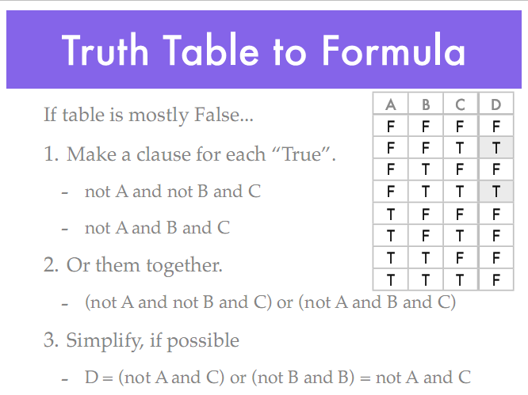

Slide 66
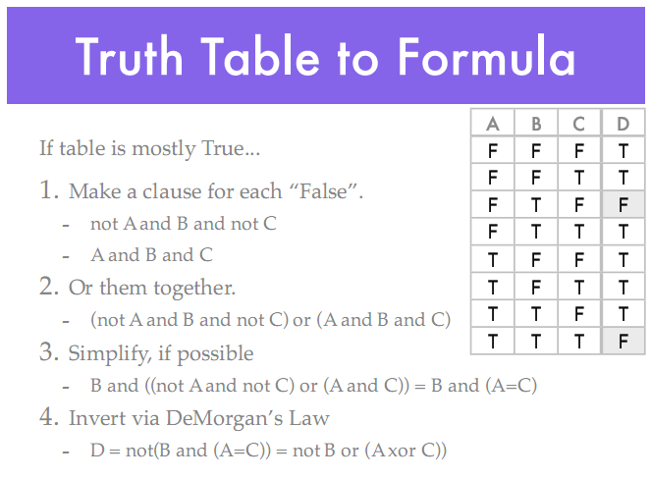

Slide 67
Random
Numbers

Slide 68
Math.random()
double decOne;
decOne = Math.random() * 10;
int intOne;
intOne = (int)(Math.random() * 10);
System.out.println(decOne);
System.out.println(intOne);
OUTPUT
8.44193167660682
6
Notes:
Math.random() returns a number between 0.0 and 1.0, not including 1.0.

Slide 69
Random Instantiation
reference variable
Random rand = new Random();
object instantiation
Always make Random vars instance vars!
Notes:
Class Random contains many useful random methods. Math.random() can be used to generate the same results as the Random class methods.

Slide 70
Random frequently used methods
Name | Use
nextInt(x) | returns a random int 0 to x(exclusive)
nextInt() | returns a random int MIN to MAX(exclusive)
nextDouble() | returns a random int 0.0 to 1.0(exclusive)
import java.util.Random;

Slide 71
Random
Random rand = new Random();
int intOne = rand.nextInt(10); //0-9
System.out.println(intOne);
intOne = rand.nextInt(50)+1; //1-50
System.out.println(intOne);
intOne = rand.nextInt(20)+20; //20-39
System.out.println(intOne);
OUTPUT7 29 37

Slide 72
open
randomone.java

Slide 73
Continue work
on Lab 10

